Slide 1

Data 211 Project: Caffeine
Analysis of Subjects Daily Caffeine Consumption

Slide 2

Data 211 Project: Caffeine
Project Concept Overview:
I like caffeine. It keeps me awake and quasi-functional. An article by the Mayo Clinic(1) suggests too much caffeine is not good for you.
Do I consume too much caffeine?
FDA/Mayo suggests 400mg is the safe, maximum daily consumption.
Mayo reports that the maximum consumption age group (50-64) consumes (226 mg/day).

Slide 3
Data 211 Project: Caffeine
Project Concept Overview:
FDA/Mayo suggests 400mg is the safe, maximum daily consumption.
Mayo reports that the maximum consumption age group (50-64) consumes (226 mg/day).
I drink and eat items that have caffeine, is there a correlation between how I consume caffeine and my overall daily intake?

Slide 4
Data 211 Project: Caffeine
Study Question 1: Does the subject consume more than the
average adult in the highest intake group (age 50-64), 226 mg?
Study Question 2: Does the subject consume more than the maximum recommend intake by the FDA/Mayo, 400 mg?
Study Question 3: Is there a correlation between liquid caffeine consumption and total caffeine? Food caffeine consumption and total caffeine?

Slide 5
Data 211 Project: Caffeine
Study Question 1: Does the subject consume more than the
average adult in the highest intake group (age 50-64), 226 mg?
Study Question 2: Does the subject consume more than the maximum recommend intake by the FDA/Mayo, 400 mg?
Study Question 3: Is there a correlation between liquid caffeine consumption and total caffeine? Food caffeine consumption and total caffeine?

Slide 6
Data 211 Project: Caffeine
Data Collected
Common sources of caffeine include:
Redbull 8.6 oz 80 mg
Coffee 8oz 144 mg
Celsius 200 mg
Chocolate (milk/dark)/oz 6-20 mg
Black tea 8oz 48 mg
Dr. Pepper 36 mg

Slide 7
Data 211 Project: Caffeine
Data Collected
Day | Date | amount total | liquid | food
1 | 10-Nov | 374 | 361 | 13
2 | 11-Nov | 396 | 380 | 16
3 | 12-Nov | 430 | 408 | 22
4 | 13-Nov | 346 | 280 | 66
5 | 14-Nov | 390 | 390 | 0
6 | 15-Nov | 460 | 410 | 50
7 | 16-Nov | 443 | 433 | 10
8 | 17-Nov | 620 | 610 | 10
9 | 18-Nov | 460 | 430 | 30
10 | 19-Nov | 290 | 280 | 10
11 | 20-Nov | 290 | 265 | 25
12 | 21-Nov | 345 | 315 | 30
13 | 22-Nov | 580 | 570 | 10
14 | 23-Nov | 620 | 610 | 10

Slide 8
Data 211 Project: Caffeine
Summary Statistics:
Average Total Consumption: 418.93 mg
Average Liquid Consumption: 397.36 mg
Average Food Consumption: 21.57 mg

Slide 9
Data 211 Project: Caffeine
Null and Alternative Hypothesis:
1) Personal Consumption greater than average of largest caffeine consumer segment group (55-64) 226 mg.
H0: mu = 226 gm
HA: mu = 226 gm
2) Personal Consumption greater than recommended maximum daily intake 400 mg.
H0: mu = 400 mg
Ha: mu > 400 mg
Is there a correlation between average intake and food?
Is there a correlation between average intake and liquid?

Slide 10
Data 211 Project: Caffeine
Null and Alternative Hypothesis:
1) Personal Consumption greater than average of largest caffeine consumer segment group (55-64) 226 mg.
H0: mu = 226 gm
HA: mu = 226 gm
One-sided T-test
t = 6.029
p-value = 2.12e -05
We reject the H0 and accept the alternative that my daily consumption is greater than the segment average of 226 mg.

Slide 11
Data 211 Project: Caffeine
Null and Alternative Hypothesis:
2) Personal Consumption greater than recommended maximum daily intake 400 mg.
H0: mu = 400 mg
Ha: mu > 400 mg
One-sided T-test
t = .5915
p-value = 0.2822
We fail to reject the H0 that my daily consumption is greater than the FDA recommended daily maximum of 400 mg.

Slide 12
Data 211 Project: Caffeine
Regression Analysis: Liquid
Residuals:
Min 1Q Median 3Q Max
-21.974 -9.413 -2.968 2.957 38.001
Coefficients:
Estimate Std. Error t value Pr(>|t|)
(Intercept) 43.33417 15.81923 2.739 0.018 *
liquid 0.94523 0.03809 24.817 1.11e-11 ***
Multiple R-squared: 0.9809
Yhat = 43.334 +0.945x
There is a correlation between my average daily intake and the liquid consumption of caffeine.

Slide 13
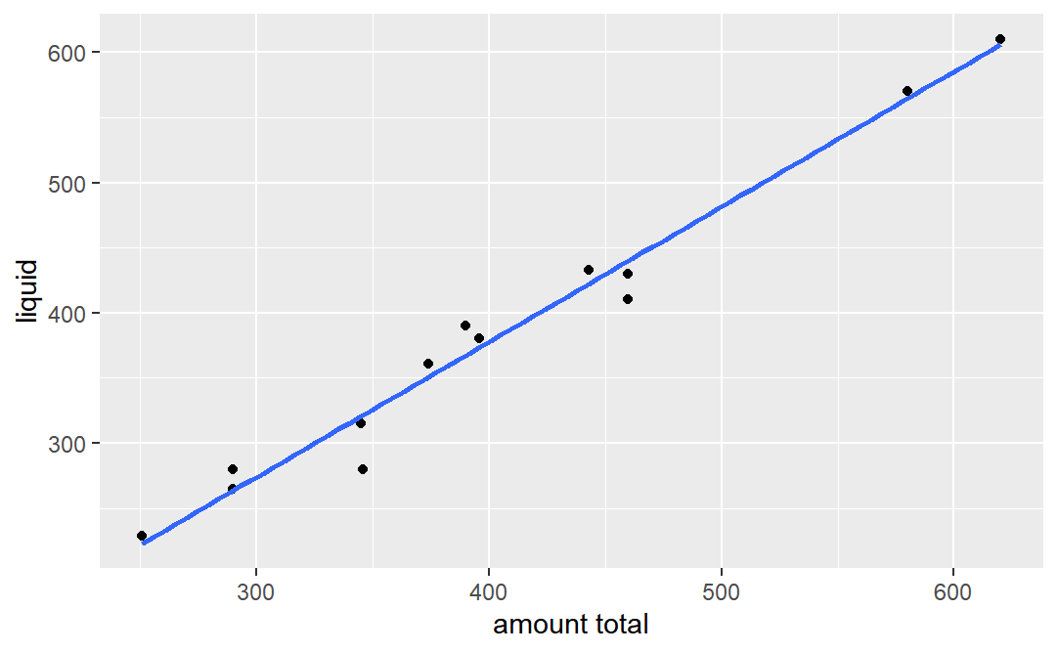
Data 211 Project: Caffeine
Regression Analysis: Liquid

Slide 14
Data 211 Project: Caffeine
Regression Analysis: Food
Residuals:
Min 1Q Median 3Q Max
-167.21 -63.87 -15.21 80.52 181.59
Coefficients:
Estimate Std. Error t value Pr(>|t|)
(Intercept) 455.250 51.572 8.827 1.35e-06 ***
food -1.684 1.866 -0.902 0.385 Multiple R-squared: 0.06352
Yhat = 455.250 -1.684x
There is no a correlation between my average daily intake and the food consumption of caffeine.

Slide 15
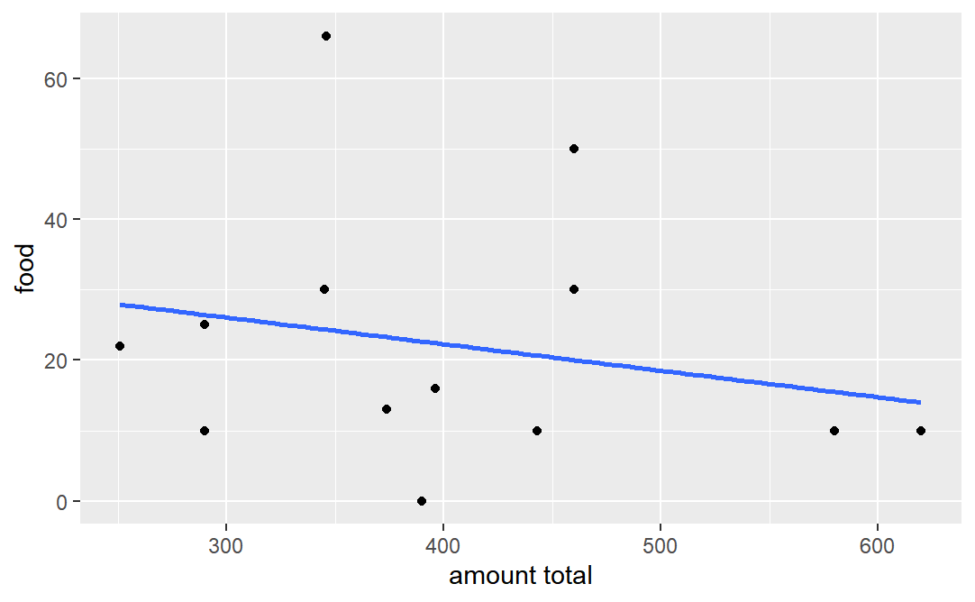
Data 211 Project: Caffeine
Regression Analysis: Food

Slide 16
Data 211 Project: Caffeine
Conclusion
There is evidence to support the conclusion that I drink more than the average 55-64 year-olds who are the most veracious consumers of caffeine.
There is also evidence to assert that I do not drink more than the maximum recommended daily intake of 400 mg. (My wife still thinks I do).
There is a correlation between my total caffeine and liquid consumption but not for food consumption.

Slide 17
Data 211 Project: Caffeine
1 Mitchell DC, Knight CA, Hockenberry J, Teplansky R, Hartman TJ. Beverage caffeine intakes in the U.S. Food Chem Toxicol. 2014 Jan;63:136-42. doi: 10.1016/j.fct.2013.10.042. Epub 2013 Nov 1. PMID: 24189158.
2 https://www.mayoclinic.org/healthy-lifestyle/nutrition-and-healthy-eating/in-depth/caffeine/art-20045678
3 more0196/Data-211-Project: Final Project for Data 211. Caffeine intake study using R. (github.com)

